Slide 1
Culling Resumes for Jobs using NLP techniques

Slide 2
GROUP MEMBER INFO: YENUGU SUMANTH-700745884 DAKEY AVINASH-700740053

Slide 3
Roles and Responsibilities: SUMANTH-Implemented the coding for loading data sets and data set collection based on the requirement for the project. AVINASH-Working on identifying the necessary papers for the project work implementation and worked on documentation.

Slide 4
Motivation
When someone publishes a job position online, they'll get several applications quickly.
Manually shifting resumes takes too much time and money for recruiting businesses to bear.
The resume-review process is unfair since many qualified individuals are overlooked.
Because of this, the job may be filled by unqualified applicants, or the best candidates may be missed.

Slide 5
OBJECTIVE
In this work, we present a system that automatically suggests the best candidates based on a job description.
Our technique utilizes natural language processing to extract important information from unstructured resumes, such as skills, education, and experience, and then summarizes each application.
Recruiters may now analyze each resume more thoroughly in less time by eliminating extraneous content throughout the screening process.
After text mining, the system uses BERT vectorization and cosine similarity to match resumes to job descriptions.
After ranking scores are determined, they may be used to identify the best applicants for a position

Slide 6
Related works Methodology - Data Preprocessing
1. Cleaning and Removing Special characters
During this step, the attached resume (CV) that is being used as input will be cleaned by removing any special characters or trash characters that may be included in the CVs.
During the cleaning process, all special characters, numerals, and words consisting of a single letter are deleted.
2. Stop words removal
Since stop words like and, the, and was, as well as others like them, exist quite frequently in the text yet contribute nothing to the prediction process, they are eliminated.
Following are the steps to filter out the Stop Words:
The grammatical rules of the English language allow for a single word to take on multiple forms when used in different phrases.
3. Tokenization
After converting the various resume formats into text (.docx,.pdf,.jpg,.rtf, etc.),
we start the tokenization process to find phrases or words that constitute a character sequence.
This is done by looking for character sequences that contain several terms or words.
This is significant because, with the help of these words[13], we will be able to extract meaning from the sequence of the original text

Slide 7
Methodology - TF-IDF
This approach is abbreviated "Term Frequency - Inverse Document Frequency" (Stecanella, 2020).
Text mining uses TF-IDF weight. TF-IDF was designed for these two goals.
A phrase's weight quantifies its importance in a collection or corpus. [9]
If a term occurs frequently, it's more important. If the term occurs in more articles, this impact is reduced.
Common terms like "this," "and," "what," "whom," "is," "the," "if," etc. are given little weight in the ranking algorithm (Stecanella, 2020).
Term Frequency measures how frequently a word occurs in each corpus document.
Because a word may occur more in lengthier articles, you must normalise its frequency.
Divide the number of times a word occurs in a document by the total number of terms.
This gives term frequency normalised. (Jabri, Siham, et al., 2018) may be expressed mathematically as the following equation.

Slide 8
Methodology - BERT Model
Google created BERT to pre-train NLP algorithms. [6] BERT uses transformers to learn.
BERT's transformer language paradigm may allow a variable number of encoder layers and self-attention heads.
BERT was pre-trained on language modelling (15 percent of tokens were concealed) and next sentence prediction (BERT was trained to predict if a chosen next sentence was probable or not given the first sentence). [7]
BERT learns word context during training.
BERT may be fine-tuned using less resources and smaller datasets after pretraining, which needs a lot of computing effort. BERT is a transformer Encoder stack.
A transformer design has encoder self-attention and decoder attention.
BERT BASE's encoder stack has 12 levels; BERTLARGE's has 24.
The original paper described a Transformer architecture (6 encoder layers).
BERT designs (BASE and LARGE) contain larger feedforward networks (768 and 1024 hidden units, respectively) and more attention heads (12 and 16, respectively).
8 attention heads and 512 hidden units. BERTBASE contains 110M parameters, BERTLARGE 340M.

Slide 9
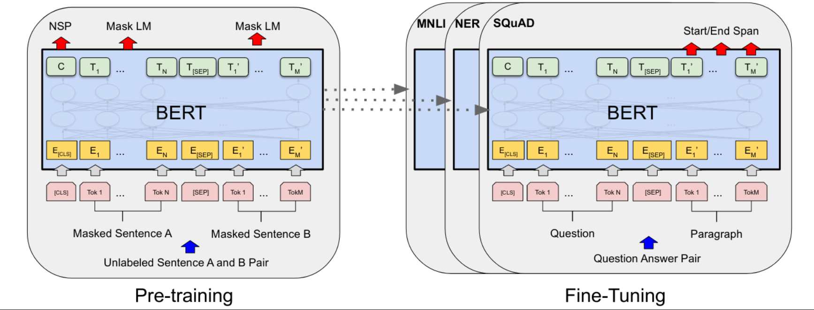
Methodology - BERT Model
Each layer conducts self-attention, then transfers the result across a feedforward network. Model produces hidden-size vector (768 for BERT BASE).
Using this model's CLS token output, we can create a classifier.
The masked language model predicts, from context alone, a masked word's original vocabulary id.
Instead of pre-training a left-to-right language model, we may learn a deep bidirectional Transformer by fusing left and right context.
BERT pre-trains text-pair representations using a masked language model and next-sentence prediction challenge. BERT pre-trains and tunes.
The model is pre-trained using unlabeled data. [8]
After starting with pre-trained parameters, the BERT model's downstream parameters are fine-tuned using labelled data. Each downstream job's models are adjusted individually but share pre-trained parameters.

Slide 10

Methodology - Cosine similarity
Similarity measures are quantitative indicators of the degree to which two entities are equivalent.
When comparing two texts of varying lengths, cosine similarity (Sidorov, Grigori, et al., 2014) is a useful metric.
When documents are plotted in N-dimensions, where each dimension represents a different aspect of the object, the resulting diagram illustrates the documents' preferred direction. [10]
Due to its symmetric nature, the results of computing the similarity of item X to item Y are identical to those of computing the similarity of item Y to item X.
We can express this in mathematical terms using the equation below

Slide 11
PROBLEM STATEMENT
Recruiters can't study every resume since so few candidates are picked.
Resume formats make it hard for companies to compare candidates.
Recruiters may access a huge pool of applicants by advertising positions online.
Electronic recruiting saves companies and job seekers time and money, but it also presents new challenges.
Recruiters must filter through applications to find the finest candidates.
These Boolean search approaches often provide worthless results, excluding competent candidates.

Slide 12
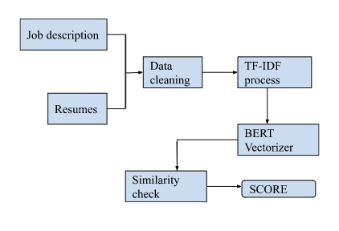
PROPOSED SOLUTION
The system uses Natural Language Processing to extract the most relevant qualifications from each résumé and organise them consistently across files.
Assessors may quickly evaluate applicants' qualifications using the shortened form.
Our algorithm ranks resumes based on job description match.

Slide 13
Steps how the proposed solution works:
The first thing to do is load up the resumes.
Step 2 involves loading the job description, followed by Step 3,
which involves cleaning up both the resumes and the job description.
Step 4 involves utilising the TF-IDF technique to isolate the most significant terms.
The fifth step involves applying the Bert model to transform the extracted words into vectors.
The score will be determined based on the comparison of the vectors in step 6.

Slide 14

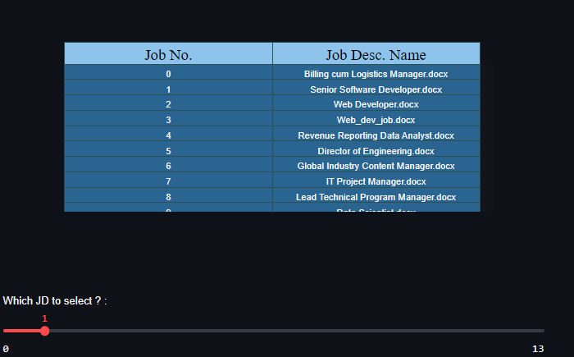
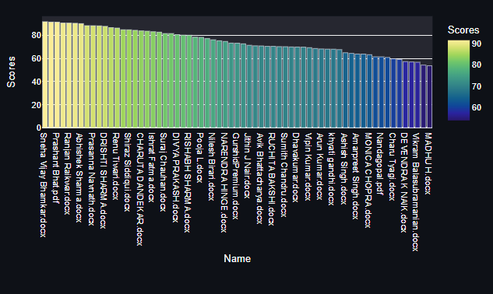
Result

Slide 15
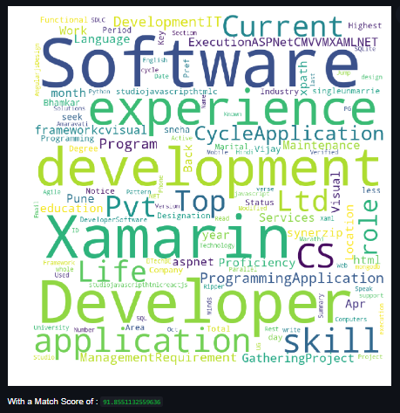
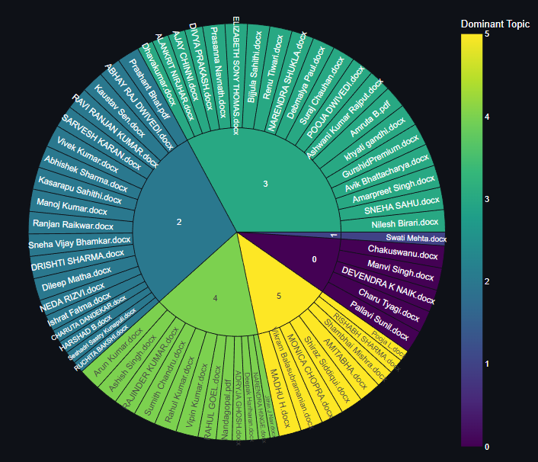
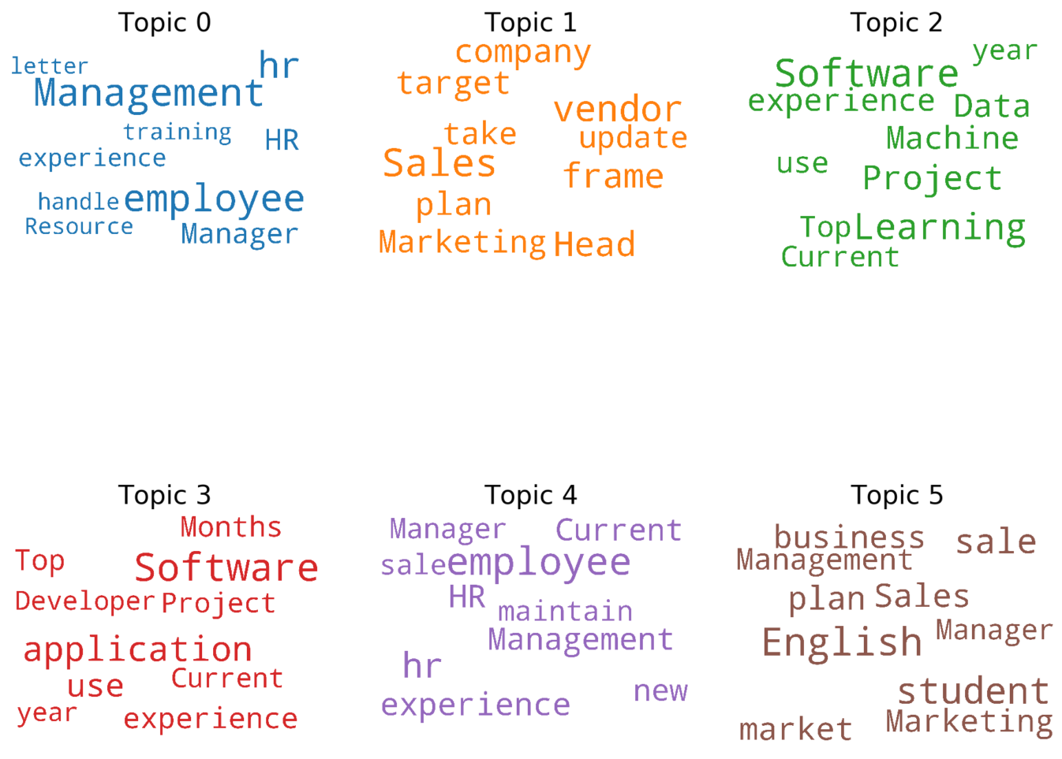
Results

Slide 16
Conclusion
Extremely high resume volume for each available post.
Employers must sift through a mound of applicants to locate the appropriate person.
Sorting resumes manually is time- and resource-consuming.
We describe a Natural Language Processing-based automated model that accomplishes precisely that based on a job description.
We designed a resume screening algorithm that speeds the recruiting process by reducing difficulties human recruiters have when shortlisting applicants for a given job position.
To tackle this, we designed a score system that compares extracted resume qualities to job description criteria using a BERT Model and similarity algorithm.
Each CV gets a similarity score, and the findings are used to rank the top N candidates by how closely they fit the job description. The recommended technique captures resumption semantics with 91.85% correctness.

Slide 17
Reference
Allahyari, M., Pouriyeh, S., Assefi, M., Safaei, S., Trippe, E.D., Gutierrez, J.B. and Kochut, K., 2017. A brief survey of text mining: Classification, clustering, and extraction techniques. arXiv preprint arXiv:1707.02919.
Arguello, J., 2013. Vector space model. Information Retrieval September, 25.
Berry, M., 2001. Computational Information Retrieval. Philadelphia: Society for Industrial and Applied Mathematics,121-144.
Bird, S., Klein, E. and Loper, E., 2009. Natural Language Processing With Python. Bejing: O'Reilly, 264.
Faliagka, E., Ramantas, K., Tsakalidis, A. and Tzimas, G., 2012, May. Application of machine learning algorithms to an online recruitment system. In Proc. International Conference on Internet and Web Applications and Services.
Devlin, Jacob; Chang, Ming-Wei; Lee, Kenton; Toutanova, Kristina (11 October 2018). "BERT: Pre-training of Deep Bidirectional Transformers for Language Understanding".
"Open Sourcing BERT: State-of-the-Art Pre-training for Natural Language Processing". Google AI Blog. Retrieved 2019-11-27..

Slide 18
Reference
Horev, Rani (2018). "BERT Explained: State of the art language model for NLP". Towards Data Science. Retrieved 27 September 2021.
Jabri, S., Dhabi, A., Gadi, T. and Bassir, A., 2018, April. Ranking of text documents using TF-IDF weighting and association rules mining. In 2018 4th International Conference on Optimization and Applications (ICOA), 1-6. IEEE.
Huang, A., 2008, April. Similarity measures for text document clustering. In Proceedings of the sixth new Zealand computer science research student conference (NZCSRSC2008), Christchurch, New Zealand, 4, 9-56.
Dr.Parkavi A, Pooja Pandey, Poornima J, Vaibhavi G S, Kaveri BW, “E-Recruitment System Through Resume Parsing, Psychometric Test and Social Media Analysis”, 2019, IJARBEST.
Satyaki Sanyal, Neelanjan Ghosh, SouvikHazra, Soumyashree Adhikary, “Resume Parser with Natural language Processing”, 2007, IJESC.
Stenella, B., 2020. What Is TF-IDF? [online] MonkeyLearn Blog. Available at: <https://monkeylearn.com/blog/what-is-tf-idf/>.
Mansouri, A., Affendey, L.S., and Mamat, A., 2008. Named entity recognition approaches. International Journal of Computer Science and Network Security, 8(2), 339-344.

